Slide 1
COURSE OBJECTIVES
1 Understand the concepts involved in the lifecycle of software development.
2 learn the best practices to be employed for the design, development, testing and maintenance of a software project.

Slide 2
COURSE OUTCOMES
On completion ofthe course, students will be able to
1 Explain the software development lifecycle models for a software
system development.
2 Build the prototype for software business case and estimate the cost for
software project development.
3 Analyze the behavioral and architectural models using UML for the
designed object oriented system.
4 Design the behavioral and architectural models using UML.
5 Identify verification and validation methods in a software engineering
project and implement testing methods at various phases of SDL

Slide 3
Chapter 1-2
Software Engineering
1

Slide 4
UNIT-I
Introduction to Software Engineering The Nature of Software: Defining Software, Software Application Domain, Legacy Software, The changing Nature of the software : WebApps, Mobile Applications, Cloud Computing, Product line software
Software Engineering : The Process Frame work, Umbrella Activities, Process Adaption, Software development myths
The Software Process: Defining framework activities, Identifying a task set, Process patterns, Process Assessment and improvement
Process Models: Prescriptive models, Waterfall Model, Incremental Process Models, Evolutionary Process Models, Specialized Process Models, The Unified Process, personal software process, Team Software Process.

Slide 5
What is Software?
Software is (programs, data, and descriptive information)
instructions (computer programs) that when executed provide desired features, function, and performance;
data structures that enable the programs to adequately manipulate information and
documentation that describes the operation and use of the programs.
5

Slide 6
What is Software?
Software is developed or engineered, it is not manufactured in the classical sense.
Software doesn't "wear out."
Although the industry is moving toward component-based construction, most software continues to be custom-built.
6

Slide 7
Hardware
Relatively high failure rates early in its life
Defects are corrected
The failure rate drops to a steady-state level for some period of time
As time passes, the failure rate rises again as hardware components suffer from the cumulative effects of dust, vibration, abuse, …
The hardware begins to wear out
7

Slide 8
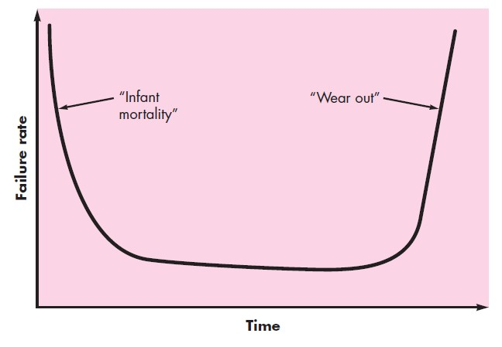
Hardware: Failure Curve
Bathtub curve
8

Slide 9
Software
Not susceptible to the environmental maladies that cause hardware to wear out
In theory, the failure rate curve for software should take the form of the “idealized curve”
Undiscovered defects will cause high failure rates early in the life of a program
These defects are corrected and the curve flattens -
➔ software doesn’t wear
But, software deteriorates!
Software will undergo change during its life
9

Slide 10

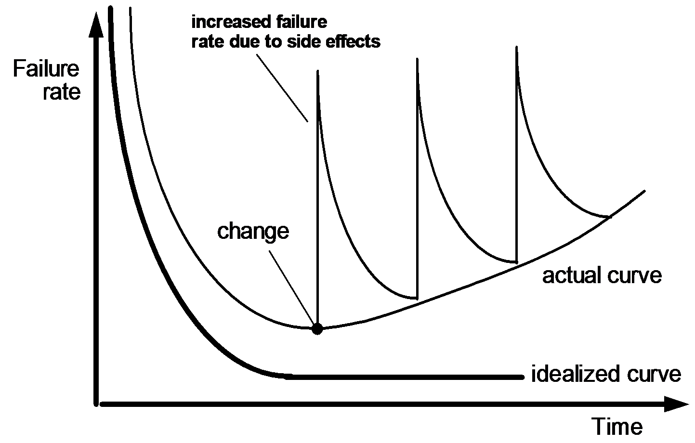
Wear vs. Deterioration
10

Slide 11
Software Applications
system software
Service other programs
Determinate: predicable inputs ➔ Compilers, editors, file management utilities
Indeterminate: unpredictable inputs ➔ Operating systems, network software
application software
Stand-alone programs that solve a specific business need
11

Slide 12
Software Applications
engineering/scientific software
A broad array of “number-crunching programs”
From astronomy to volcanology
From automotive stress analysis to orbital dynamics
From computer-aided design to molecular biology
From genetic analysis to meteorology
embedded software
Resides within a product or system and is used to implement and control features and functions for the end user and for the system itself
product-line software
Designed to provide a specific capability for use by many different customers
Inventory control products
12

Slide 13
Software Applications
WebApps (Web applications)
Browser-based apps
Software that resides on mobile devices
AI software
Makes use of nonnumerical algorithms to solve complex problems that are not amenable to computation or straightforward analysis
Robotics
Expert systems
Pattern recognition (image, voice and text)
Artificial neural networks
Theorem proving
Game playing
13

Slide 14
Software—New Categories
Open world computing—pervasive, distributed
computing
Ubiquitous computing(existing everywhere)—wireless networks
Netsourcing—the Web as a computing engine
Open source—”free” source code open to the computing community (a blessing, but also a potential curse!)
Also …
Grid computing( a network of computers working together to perform a task that would rather be difficult for a single)
Cognitive machines
Software for nanotechnologies
14

Slide 15
Legacy Software
Legacy software
Very old programs
Support core business functions and are indispensable to the business
Has been the focus of continuous attention and
concern since the 1960s
Characteristics
Longevity
Business criticality
15

Slide 16
Legacy Software: Negative characteristic
Poor Quality
Inextensible designs
Convoluted(difficult) code
Poor or nonexistent documentation
Test cases and results that were never archived
Poorly managed change history
What do we do if we meet a legacy system that
exhibits poor quality?
Do nothing, at least until the legacy system must undergo some significant change ➔ Is it okay?
16

Slide 17
Legacy Software: Often Evolves
Why must it change?
software must be adapted to meet the needs of new computing environments or technology.
software must be enhanced to implement new
business requirements.
software must be extended to make it interoperable with other more modern systems or databases.
software must be re-architected to make it
viable within a network environment.
If evolution occurs, a legacy system must be reengineered so that it remains viable into the future
14

Slide 18
Software: The Changing Nature
Some categories of software are evolving to dominate the industry, but they are in their infancy little more than a decade ago
1) WebApps
2) Mobile application
3) Cloud computing
4) Product line software

Slide 19
WebApps
In the early days of WWW, websites consists of little more than a set of linked hypertext files
As time passed, the augmentation of HTML enabled Web engineers to provide computing capability along with informational content ➔ Web-based systems and applications (WebApps)
Today, WebApps have evolved into sophisticated computing tools
Provide stand-alone function to the end user
Have been integrated with corporate databases and
business applications

Slide 20
WebApps: Evolution
Previously, WebApps involve a mixture b/w print publishing and software development, b/w marketing and computing, b/w internal communications and external relations, and b/w art and technology
Today, WebApps provide full computing potential in most application categories
Semantic Web Technology (Web 3.0)
Encompass “semantic databases that provide new functionality that requires Web linking, flexible representation, and external access APIs”
Sophisticated relational data structure ➔ entirely new WebApps in ways never before possible

Slide 21
WebApps: Characteristics
Network intensiveness. A WebApp resides on a network and
must serve the needs of a diverse community of clients.
Concurrency. A large number of users may access the WebApp at one time.
Unpredictable load. The number of users of the WebApp may
vary by orders of magnitude from day to day.
Performance. If a WebApp user must wait too long (for access, for server-side processing, for client-side formatting and display), he or she may decide to go elsewhere.
Availability. Although expectation of 100 percent availability is unreasonable, users of popular WebApps often demand access on a “24/7/365” basis.

Slide 22
WebApps: Characteristics
Data driven. The primary function of many WebApps is to use hypermedia to present text, graphics, audio, and video content to the end-user.
Content sensitive. The quality and aesthetic nature of content remains an important determinant of the quality of a WebApp.
Continuous evolution. Unlike conventional application software that evolves over a series of planned, chronologically-spaced releases, Web applications evolve continuously.
Immediacy. Although immediacy—the compelling need to get software to market quickly—is a characteristic of many application domains, WebApps often exhibit a time to market that can be a matter of a few days or weeks.
Security. Because WebApps are available via network access, it is difficult, if not impossible, to limit the population of end-users who may access the application.
Aesthetics. An undeniable part of the appeal of a WebApp is its look and feel.

Slide 23
Mobile Applications
App
Has evolved to software that has been specifically designed to reside on a mobile platform
Mobile apps encompass
1) a user interface that uses features provided by the mobile platform,
2) interoperability with Web-based resources,
3) local processing capabilities that collect, analyze, and format information,
4) persistent storage capabilities

Slide 24
Mobile Applications
Mobile web application (Webapp)
Allows a mobile device to gain access to web-based content via a browser
Mobile app
Can gain direct access to the hardware characteristics of the device
Accelerometer, GPS location
The distinction b/w mobile WebApps and mobile apps will blur as mobile browers becomes more sophisticated

Slide 25
Cloud computing
an infrastructure or “ecosystem” that enables any user, anywhere to use a computing device to share computing resources on a broad scale
Computing devices in cloud computing
Reside outside the cloud
Have access to a variety of resources within the cloud
The resources include
1) applications, 2) platforms, 3) infrastructure
In the simplest form
an external computing device accesses the cloud via a Web browser

Slide 26
Cloud computing: Implementation issue
Requires the development of front-end and back-end services
Similar to Client-server architecture
Front-end
The client device
The application software (e.g. browser)
Back-end
Servers
Related computing resources
Data storage systems (e.g. databases)
Server-resident applications
Administrative servers

Slide 27
Software product line
Definition
A set of software-intensive systems that share a common, managed set of features satisfying the specific needs of a particular market segment and mission and that are developed from a common set of core assets in a prescribed way
Reuse all across the product line!
All developed using the same underlying application and data architectures
All implemented using a set of reusable software components leads to significant engineering leverages

Slide 28
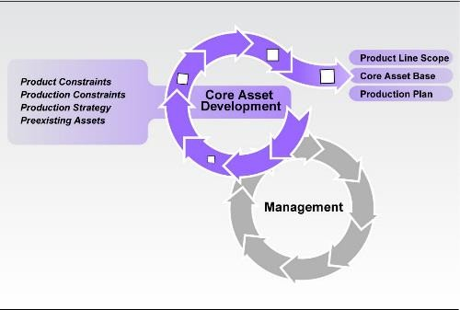
Software product line

Slide 29
Chapter 1: Summary
Software
The key element in the evolution of computer-based systems and products
One of the most important technologies on the world
Stage
Over the past 50 years, software has evolved from a specialized problem solving and information analysis tool to an industry in itself
Yet we have trouble developing high-quality software on time and within budget
Software (programs, data, descriptive information): addresses a wide array of technology and application areas

Slide 30
Chapter 1: Summary
Legacy software: continues to present special challenges to those who must maintain it.
The nature of software is changing
Web-based systems and applications have evolved
Mobile applications present new challenges as apps
migrate to a wide array of platforms
Cloud computing will transform the way in which software is delivered and the environment in which it exists
Product line software offers potential efficiencies in the manner in which software is built

Slide 31
Software Engineering
Some realities:
a concerted effort should be made to understand the problem before a software solution is developed
design becomes a pivotal activity
software should exhibit high quality
software should be maintainable
The seminal definition:
[Software engineering is] the establishment and use of sound engineering principles in order to obtain economically software that is reliable and works efficiently on real machines.

Slide 32
Software Engineering: Definition of Discipline
The IEEE definition:
Software Engineering: (1) The application of a systematic, disciplined, quantifiable approach to the development, operation, and maintenance of software; that is, the application of engineering to software. (2) The study of approaches as in (1).
And yet, a “systematic, disciplined and quantifiable” approach applied by one software team may be burdensome to another
We need discipline, but also need adaptability and agility

Slide 33






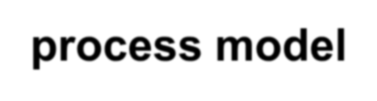

Software Engineering: A Layered Technology
tools
methods process model
a “quality” focus
Software Engineering

Slide 34
Software Engineering: Quality focus
Quality focus: Bedrock that supports software engineering
Any engineering approach (including software engineering) must rest on an organizational commitment to quality
Total quality management, Six Sigma, and similar philosophies foster a continuous process improvement culture
This ultimately leads to the development of increasingly more effective approaches to software engineering

Slide 35
Software Engineering Process
Process layer: The foundation of software engineering
Process
Is the glue that holds the technology layers together
Enables rational and timely development of computer Software
Defines a framework that must be established for effective delivery of software engineering technology
Forms the basis for management control of software Projects
Establishes the context in which technical methods are applied, work products are produced, milestones are established, quality is ensured, and change is properly managed

Slide 36
Software Engineering Methods
Methods
Provide the technical how-to’s for building software
Encompass a broad array of tasks that include communication, requirements analysis, design modeling, program construction, testing, and support
Rely on a set of basic principles that govern each area of the technology and include modeling activities and other descriptive techniques

Slide 37
Software Engineering Tools
Tools
Provides automated or semi-automated support for the process and the methods
Computer-aided software engineering
Tools are integrated so that information created by one tool can be used by another

Slide 38
Process Framework: Iteration
communication, planning, modeling, construction, and deployment are applied repeatedly through a number of project iterations.
Each project iteration produces a software increment that provides stakeholders with a subset of overall software features and functionality.
For each increment, the software becomes more and more complete

Slide 39
Umbrella Activities: Typical setting
Software project management
Formal technical reviews
Software quality assurance
Software configuratiaon management
Work product preparation and production
Reusability management
Measurement
Risk management

Slide 40
Umbrella Activities
Software project tracking and control
Allows the software team to assess progress against the project plan and take any necessary action to maintain the schedule
Risk management
Accesses risks that may affect the outcome of the project or the quality of the product
Software quality assurance
Defines and conducts the activities required to ensure software quality

Slide 41
Umbrella Activities
Technical reviews
Access software engineering work products in an effort to uncover and remove errors before they are propagated to the next activity
Measurement
Defines and collects process, project, and product measures that assist the team in delivering software that meets stakeholders’ needs; can be used in conjunction with all other framework and umbrella activities
Software configuration and management
Manages the effects of change throughout the software process

Slide 42
Umbrella Activities
Reusability management
Defines criteria for work product reuse (including software components) and establishes mechanisms to achieve reusable components
Work product preparation and production
Encompass the activities required to create work products such as models, documents, logs, forms, and lists

Slide 43
Process Adaptation
software engineering process should be agile(able to move quickly) and adaptable (to the problem, to the project, to the team, and to the organizational culture).
a process adopted for one project might be significantly different than a process adopted for another project

Slide 44
Process Adaptation: Differences
the overall flow of activities, actions, and tasks and the
interdependencies among them
the degree to which actions and tasks are defined within each framework activity
the degree to which work products are identified and required
the manner which quality assurance activities are applied
the manner in which project tracking and control activities are applied

Slide 45
Process Adaptation: Differences
the overall degree of detail and rigor with which the process is described
the degree to which the customer and other stakeholders
are involved with the project
the level of autonomy given to the software team
the degree to which team organization and roles are prescribed

Slide 46
Software Engineering Practice
We have generic framework activities— communication, planning, modeling, construction, and deployment—and umbrella activities establish a skeleton architecture for software engineering work.
How does the practice of software engineering fit in?
We now gain a basic understanding of the generic concepts and principles that apply to framework activities

Slide 47
The Essence of Practice
Polya suggests:
Understand the problem (communication and analysis).
Plan a solution (modeling and software design).
Carry out the plan (code generation).
Examine the result for accuracy (testing and quality assurance).

Slide 48
Understand the Problem
Who has a stake in the solution to the problem?
That is, who are the stakeholders?
What are the unknowns? What data, functions, and features are required to properly solve the problem?
Can the problem be compartmentalized? Is it possible to represent smaller problems that may be easier to understand?
Can the problem be represented graphically?
Can an analysis model be created?

Slide 49
Plan the Solution
Have you seen similar problems before? Are there patterns that are recognizable in a potential solution? Is there existing software that implements the data, functions, and features that are required?
Has a similar problem been solved? If so, are elements of the solution reusable?
Can subproblems be defined? If so, are solutions readily apparent for the subproblems?
Can you represent a solution in a manner that leads to effective implementation? Can a design model be created?

Slide 50
Carry Out the Plan
Does the solution conform to the plan? Is source code traceable to the design model?
Is each component part of the solution provably correct?Has the design and code been reviewed, or better, have correctness proofs been applied to algorithm?

Slide 51
Examine the Result
Is it possible to test each component part of the solution? Has a reasonable testing strategy been implemented?
Does the solution produce results that conform to the data, functions, and features that are required? Has the software been validated against all stakeholder requirements?

Slide 52
Hooker’s General Principles
1: The Reason It All Exists
2: (Keep It Simple, Stupid!)
3: Maintain the Vision
4: What You Produce, Others Will Consume
5: Be Open to the Future
6: Plan Ahead for Reuse
7: Think!

Slide 53
The Reason It All Exists
A software system exists for one reason: to provide value to its users. All decisions should be made with this in mind.
Before specifying a system requirement, before noting a piece of system functionality, before determining the hardware platforms or development processes, ask yourself questions such as: “Does this add real value to the system?”
If the answer is “no,” don’t do it. All other principles support this one.

Slide 54
Keep It Simple
Software design is not a haphazard process.
There are many factors to consider in any design effort. All design should be as simple as possible, but no simpler.
The more elegant designs are usually the more simple ones

Slide 55
Maintain the Vision
A clear vision is essential to the success of a software project.
Without one, a project almost unfailingly ends up being “of two [or more] minds” about itself.
Without conceptual integrity, a system threatens to become a patchwork of incompatible designs, held together by the wrong kind of screws.
Having an empowered architect who can hold the vision and enforce compliance helps ensure a very successful software project.

Slide 56
What You Produce, Others Will Consume
In some way or other, someone else will use, maintain, document, or otherwise depend on being able to understand your system.
So, always specify, design, and implement knowing someone else will have to understand what you are doing.
Specify with an eye to the users.
Design, keeping the implementers in mind.
Code with concern for those that must maintain and extend the system.
Someone may have to debug the code you write, and that makes them a user of your code.
Making their job easier adds value to the system.
62

Slide 57
Be Open to the Future
A system with a long lifetime has more value.
True “industrial-strength” software systems must endure far longer.
To do this successfully, these systems must be ready
to adapt to these and other changes
Never design yourself into a corner.
Always ask “what if,” and prepare for all possible answers by creating systems that solve the general problem, not just the specific one
This could very possibly lead to the reuse of an entire system

Slide 58
Plan Ahead for Reuse
Reuse saves time and effort
Achieving a high level of reuse is arguably the hardest goal to accomplish in developing a software system
The reuse of code and designs has been proclaimed as a major benefit of using object-oriented technologies
Planning ahead for reuse reduces the cost and increases the value of both the reusable components and the systems into which they are incorporated.

Slide 59
Think!
Placing clear, complete thought before action almost always produces better results.
When you think about something, you are more likely to do it right. You also gain knowledge about how to do it right again.
A side effect of thinking is learning to recognize when you don’t know something, at which point you can research the answer.
Applying the first six principles requires intense thought, for which the potential rewards are enormous.
65

Slide 60
Software Myths
Affect managers, customers (and other non-technical stakeholders) and practitioners
Are believable because they often have elements of truth,
but …Invariably lead to bad decisions,therefore …
Insist on reality as you navigate your way through software engineering

Slide 61
Management myths
Myth: We already have a book that’s full of standards and procedures for building software. Won’t that provide my people with everything they need to know?
Reality: The book of standards may very well exist, but is it used? Are software practitioners aware of its existence? Does it reflect modern software engineering practice? Is it complete? Is it adaptable? Is it streamlined to improve time-to-delivery while still maintaining a focus on quality? In many cases, the answer to all of these questions is “no.”

Slide 62
Management myths
Myth: If we get behind schedule, we can add more programmers and catch up (sometimes called the “Mongolian horde” concept).
Reality: Software development is not a mechanistic process like manufacturing. In the words of Brooks [Bro95]: “adding people to a late software project makes it later.” At first, this statement may seem counterintuitive. However, as new people are added, people who were working must spend time educating the newcomers, thereby reducing the amount of time spent on productive development effort. People can be added but only in a planned and well coordinated manner.

Slide 63
Management myths
Myth: If I decide to outsource the software project to a third party, I can just relax and let that firm build it.
Reality: If an organization does not understand how to manage and control software projects internally, it will invariably struggle when it outsources software projects.

Slide 64
Customer myths
Myth: A general statement of objectives is sufficient to begin writing programs—we can fill in the details later
Reality: Although a comprehensive and stable statement of requirements is not always possible, an ambiguous “statement of objectives” is a recipe for disaster.
Unambiguous requirements (usually derived iteratively) are developed only through effective and continuous communication between customer and developer.

Slide 65
Customer myths
Myth: Software requirements continually change, but change can be easily accommodated because software is flexible.
Reality: It is true that software requirements change, but the impact of change varies with the time at which it is introduced. When requirements changes are requested early (before design or code has been started), the cost impact is relatively small. However, as time passes, the cost impact grows rapidly— resources have been committed, a design framework has been established, and change can cause upheaval that requires additional resources and major design modification.

Slide 66
Practitioner’s myths
Myth: Once we write the program and get it to work, our job is done
Reality: Someone once said that “the sooner you begin ‘writing code,’ the longer it’ll take you to get done.” Industry data indicate that between 60 and 80 percent of all effort expended on software will be expended after it is delivered to the customer for the first time.

Slide 67
Practitioner’s myths
Myth: Until I get the program “running” I have no way of assessing its quality.
Reality: One of the most effective software quality assurance mechanisms can be applied from the inception of a project—the technical review. Software reviews (described in Chapter 15) are a “quality filter” that have been found to be more effective than testing for finding certain classes of software defects

Slide 68
Practitioner’s myths
Myth: The only deliverable work product for a successful project is the working program.
Reality: A working program is only one part of a software configuration that includes many elements. A variety of work products (e.g., models, documents, plans) provide a foundation for successful engineering and, more important, guidance for software support

Slide 69
Practitioner’s myths
Myth: Software engineering will make us create voluminous and unnecessary documentation and will invariably slow us down.
Reality: Software engineering is not about creating documents. It is about creating a quality product. Better quality leads to reduced rework. And reduced rework results in faster delivery times.

Slide 70
How It all Starts
SafeHome:
Every software project is precipitated by some business need
the need to correct a defect in an existing application
The need to adapt a ‘legacy system’ to a changing
business environment;
the need to extend the functions and features of an existing application, or
the need to create a new product, service, or system.

Slide 71
Software Process
Process is a collection of activities, actions, and tasks that are performed when some work product is to be created
Activity
Strives to achieve a broad objective (e.g. communication)
Is applied regardless of the application domain, size of the project, complexity of the effort
Action(e.g. architectural design)
Encompasses a set of tasks that produce a major work product
Task
Focuses on a small, but well-defined objective that produces a tangible outcome

Slide 72
Software Process
Process is not a rigid prescription for how to build computer software
But, it is an adaptable approach that enables the people doing the work to pick and choose the application set of work actions and tasks
The intent is to deliver software in a timely manner and with sufficient quality

Slide 73
Process Framework(Model)
Establishes the foundation for a complete software engineering process by identifying a small number of framework activities
That are applicable to all software projects,regardless of their size or complexity
Encompasses a set of umbrella activities
That are applicable across the entire software process

Slide 74
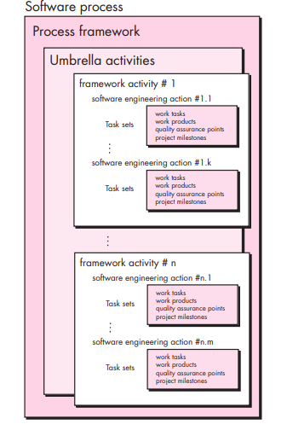

Slide 75
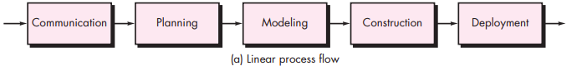

Slide 76
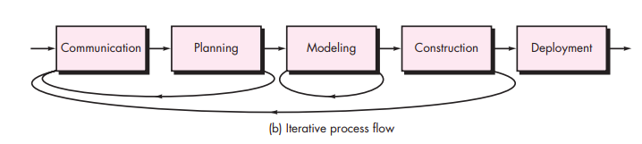

Slide 77
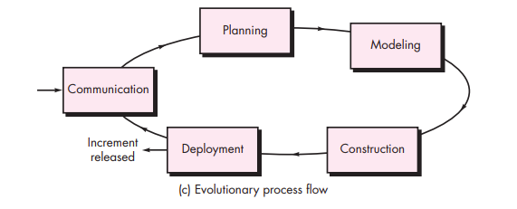

Slide 78
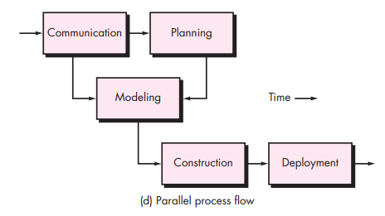

Slide 79
Framework Activities: General setting
Communication
Planning
Modeling
Analysis of requirements
Design
Construction
Code generation
Testing
Deployment

Slide 80
Communication
Before any technical work can commence, it is critically important to communicate and collaborate with the customer (and other stakeholders)
The intent is to understand stakeholders’ objectives for the project and to gather requirements that help define software features and functions.

Slide 81
Planning
Any complicated journey can be simplified if a map exists.
A software project is a complicated journey, and the planning activity creates a “map” that helps guide the team as it makes the journey.
The map—called a software project plan— defines the software engineering work by describing the technical tasks to be conducted, the risks that are likely, the resources that will be required, the work products to be produced, and a work schedule.

Slide 82
Modeling
Whether you’re a landscaper, a bridge builder, an aeronautical engineer, a carpenter, or an architect, you work with models every day.
You create a “sketch” of the thing so that you’ll understand the big picture
What it will look like architecturally, how the constituent parts fit together, and many other characteristics.
If required, you refine the sketch into greater and greater detail in an effort to better understand the problem and how you’re going to solve it.
A software engineer does the same thing by creating models to better understand software requirements and the design that will achieve those requirements.
42

Slide 83
Construction
Code generation (either manual or automated) and the testing that is required to uncover errors in the code.

Slide 84
Deployment
The software (as a complete entity or as a partially completed increment) is delivered to the customer who evaluates the delivered product and provides feedback based on the evaluation.

Slide 85
Software Process Steps
Defining framework activities
Identifying a task set
Process patterns
Process Assessment and improvement

Slide 86
Defining framework activities
What actions are appropriate for a framework activity, given the nature of the problem to be solved,
the characteristics of the people doing the work,
and the stakeholders who are sponsoring the project?

Slide 87
For a small software project requested by one person (at a remote location) with simple, straightforward requirements, the communication activity might encompass little more than a phone call with the appropriate stakeholder
1.Make contact with stakeholder via telephone.
2. Discuss requirements and take notes. How does a framework activity change as the nature of the project changes?
3. Organize notes into a brief written statement of requirements.
4. E-mail to stakeholder for review and approval

Slide 88
If the project was considerably more complex with many stakeholders, each with a different set of (sometime conflicting) requirements, the communication activity might have six distinct actions .
inception,
elicitation,
elaboration,
negotiation,
specification, and
validation.

Slide 89
Identifying a task set
A task set defines the actual work to be done to accomplish the objectives of a software engineering action.
For example, elicitation (more commonly called “requirements gathering”) is an important software engineering action that occurs during the communication activity.
The goal of requirements gathering is to understand what various stakeholders want from the software that is to be built.

Slide 90
For a small, relatively simple project, the task set for requirements gathering might look like this:
Make a list of stakeholders for the project.
Invite all stakeholders to an informal meeting.
Ask each stakeholder to make a list of features and functions required.
Discuss requirements and build a final list.
Prioritize requirements.
Note areas of uncertainty.

Slide 91
For a larger, more complex software project, a different task set would be required. It might encompass the following work tasks:
Make a list of stakeholders for the project.
2.Interview each stakeholder separately to determine overall
wants and needs. INF
O
Build a preliminary list of functions and features based on stakeholder input.
Schedule a series of facilitated application specification meetings.
Conduct meetings.

Slide 92
Produce informal user scenarios as part of each meeting.
Refine user scenarios based on stakeholder feedback.
Build a revised list of stakeholder requirements.
Use quality function deployment techniques to prioritize requirements.
Package requirements so that they can be delivered incrementally.
Note constraints and restrictions that will be placed on the system.
Discuss methods for validating the system.
Both of these task sets achieve “requirements gathering,”

Slide 93
Process Patterns
Process patterns define a set of activities, actions, work tasks,work
products and/or related behaviors
A template is used to define a pattern
Typical examples:
Customer communication (a process activity)
Planning (an action)
Analysis (an action)
Requirements gathering (a process task)
Reviewing a work product (a process task)
Design model (a work product)
Construction
Deployment

Slide 94
process pattern provides you with a template [Amb98]—a consistent method for describing problem solutions within the context of the software process.
By combining patterns, a software team can solve problems and construct a process that best meets the needs of a project.
patterns can be used to describe a problem (and solution) associated with a framework activity (e.g., planning) or an action within a framework activity (e.g., project estimating)

Slide 95
Pattern Name. The pattern is given a meaningful name describing it within the context of the software process (e.g., TechnicalReviews).
Forces. The environment in which the pattern is encountered and the issues that make the problem visible and may affect its solution.
Type
Stage pattern—defines a problem associated with a framework activity for the process. Since a framework activity encompasses multiple actions and work tasks, An example of a stage pattern might be EstablishingCommunication

Slide 96
. 2. Task pattern—defines a problem associated with a software engineering action or work task and relevant to successful software engineering practice (e.g., RequirementsGathering is a task pattern).
3. Phase pattern—define the sequence of framework activities that occurs within the process, even when the overall flow of activities is iterative in nature. An example of a phase pattern might be SpiralModel or Prototyping.

Slide 97
4.Initial context. Describes the conditions under which the pattern applies. Prior to the initiation of the pattern:
(1) What organizational or team-related activities have already occurred?
(2) What is the entry state for the process?
(3) What software engineering information or project information already exists?

Slide 98
5.Problem. The specific problem to be solved by the pattern.
6.Solution. Describes how to implement the pattern successfully
7.Resulting Context. Describes the conditions that will result once the pattern has been successfully implemented.
8.Related Patterns. Provide a list of all process patterns that are directly related to this one.
9.Known Uses and Examples. Indicate the specific instances in which the pattern is applicable.

Slide 99

Process Assessment
The process should be assessed to ensure that it meets a set of basic process criteria that have been shown to be essential for a successful software engineering.
SCAMPI: Standard CMMI(Capability Maturity Model Integration ) Appraisal Method for Process Improvement provides a Five-step model: initiating, diagnosing, establishing, acting, learning.
CBA IPI: Cost Benefit Analysis CMM Based Appraisal for Internal Process Improvement. This Uses SEI MM(software Engineering Institute Capability Maturity Model ) ; a diagnostic technique for assessing the relative maturity of software organizations

Slide 100
Process Assessment
SPICE : Software Process Improvement and Capability Determination is a standard defining set of requirements for software process assessment. Intent is To assist in developing an objective evaluation of the efficacy of any defined S/W process
ISO 9001:2000: Generic standard that applies to any organization intent on improving the overall quality of the products, systems or services. This standard is directly applicable to S/W organizations and companies.

Slide 101
Assessment and Improvement

Slide 102
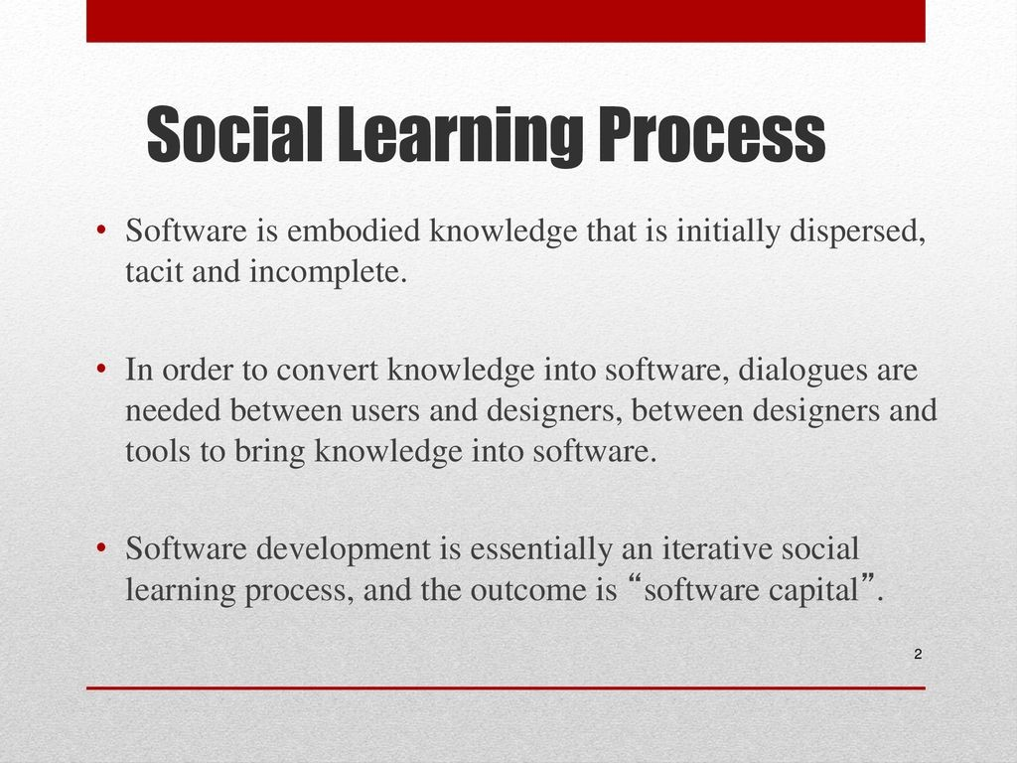

Slide 103
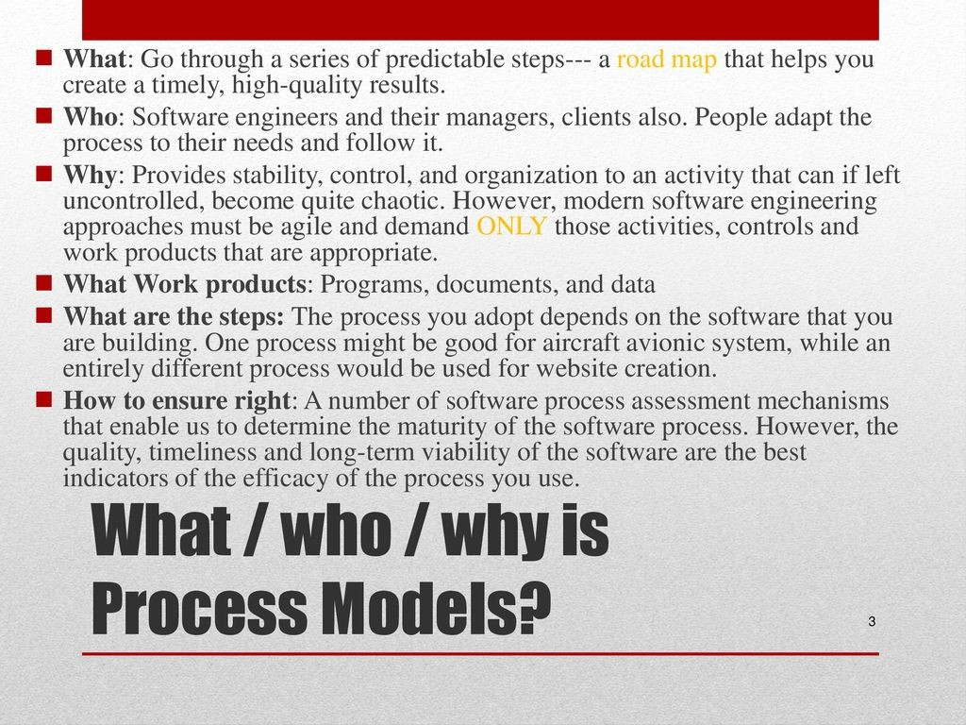

Slide 104
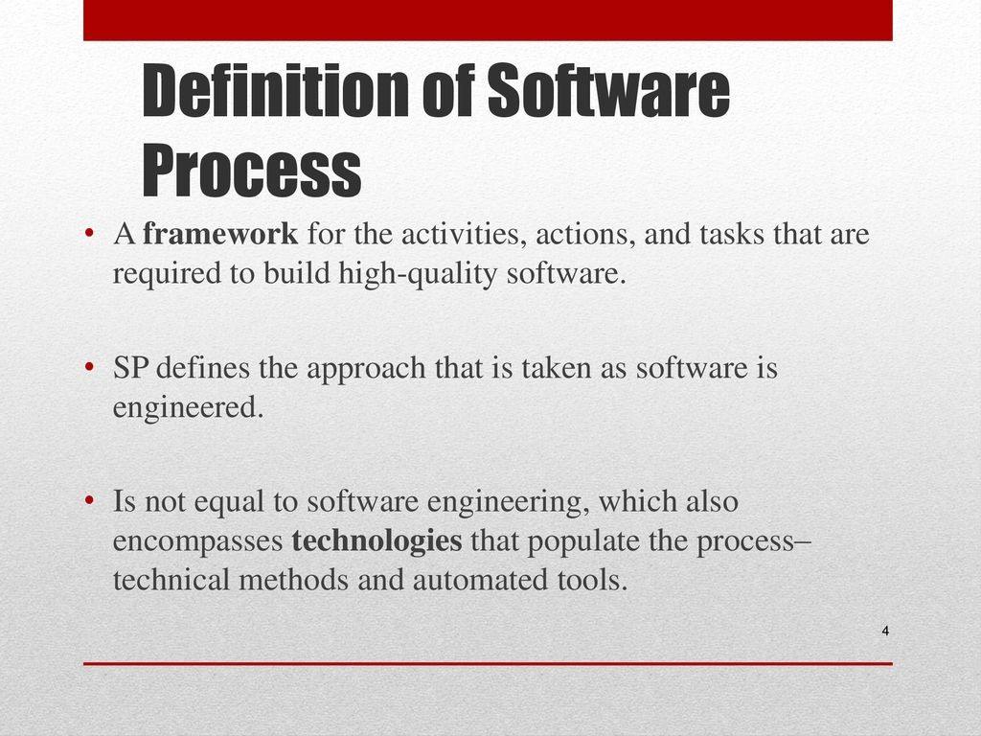

Slide 105
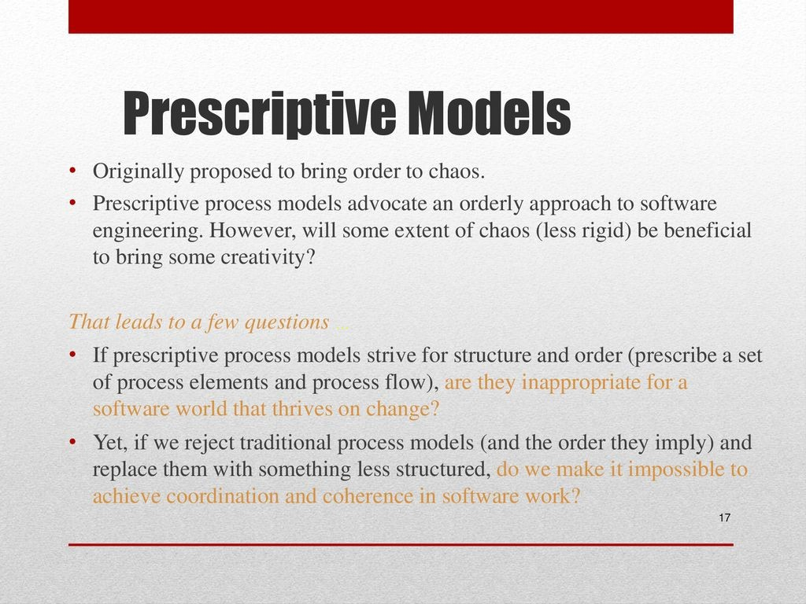

Slide 106
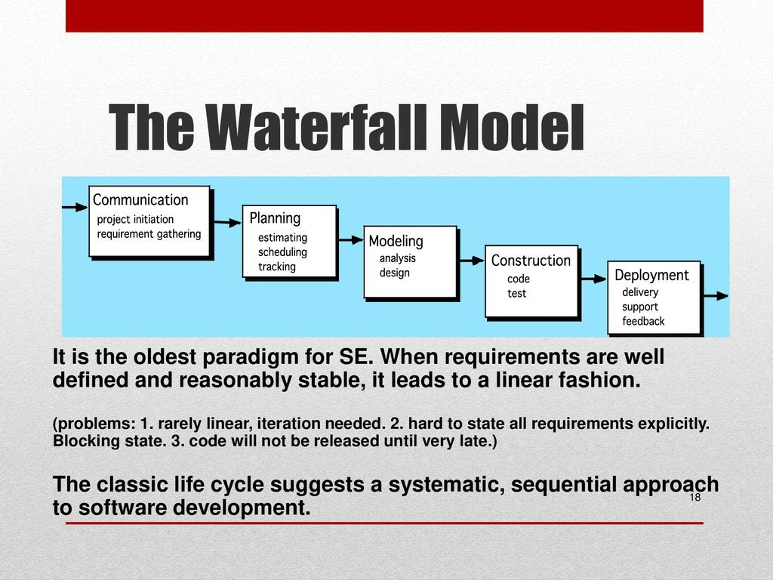

Slide 107
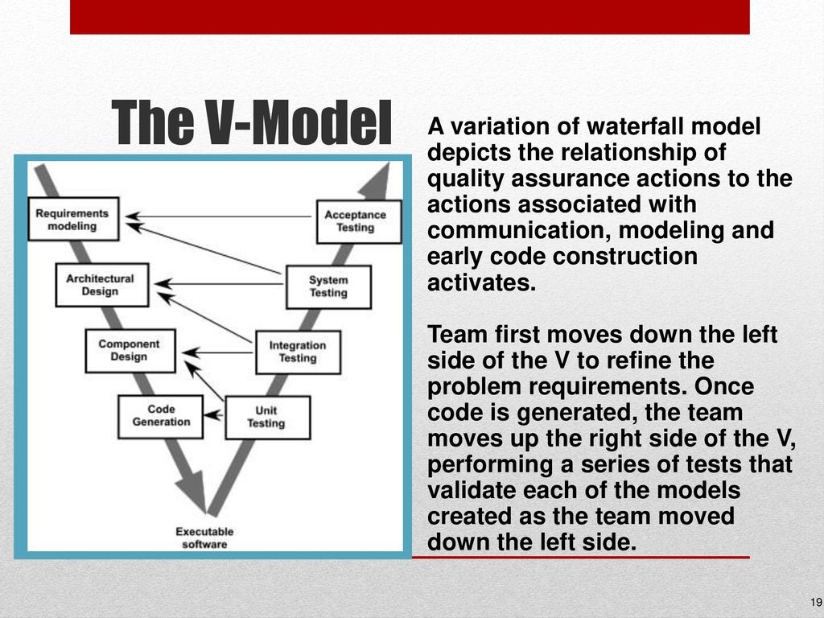

Slide 108
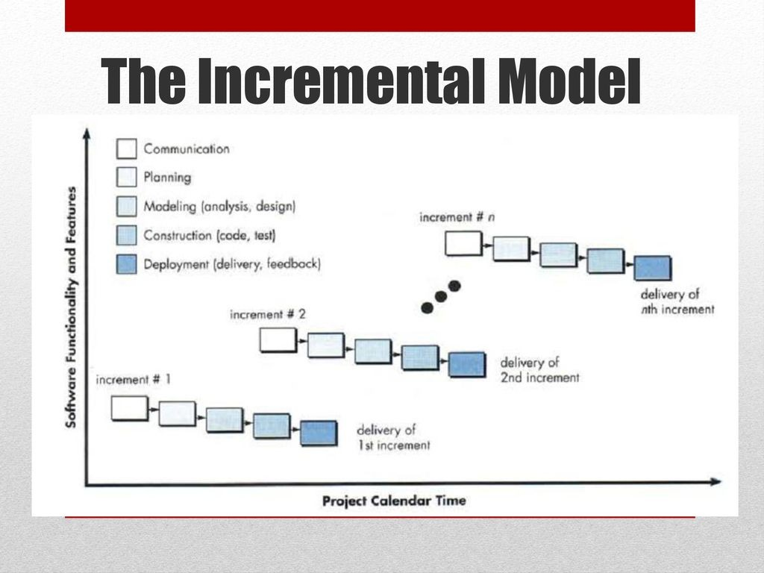

Slide 109
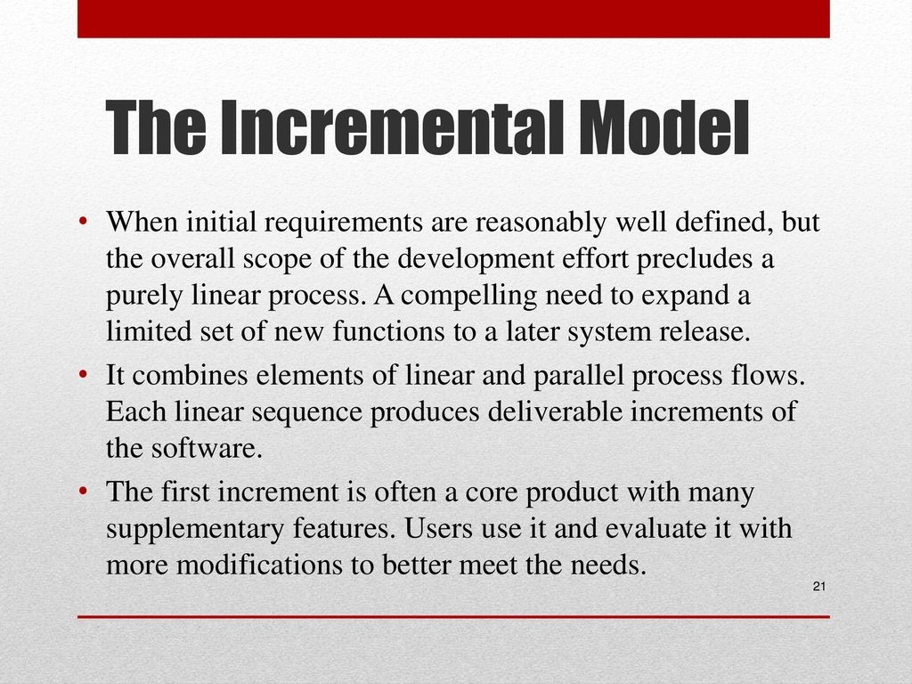

Slide 110
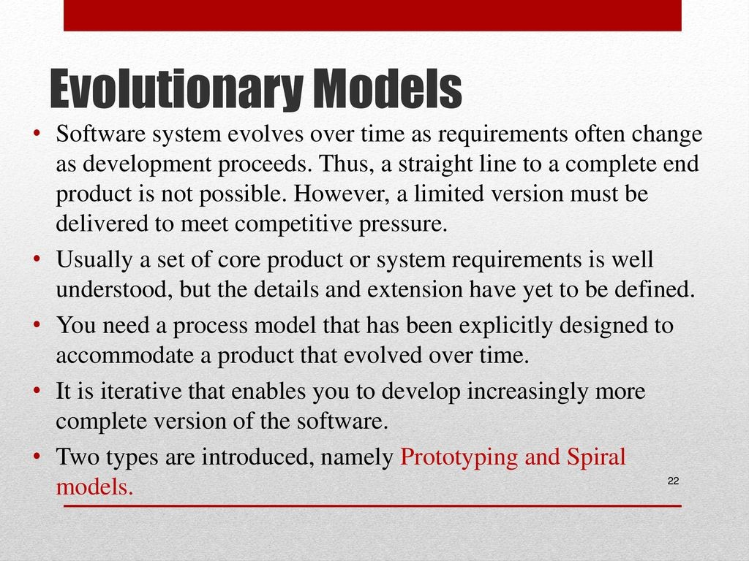

Slide 111
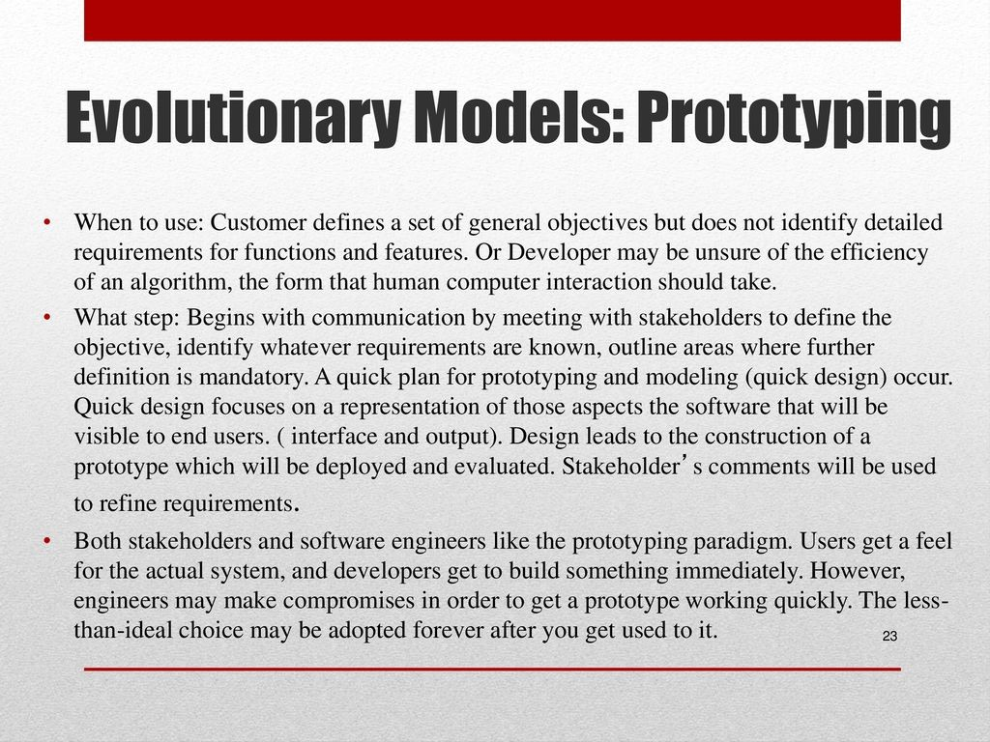

Slide 112
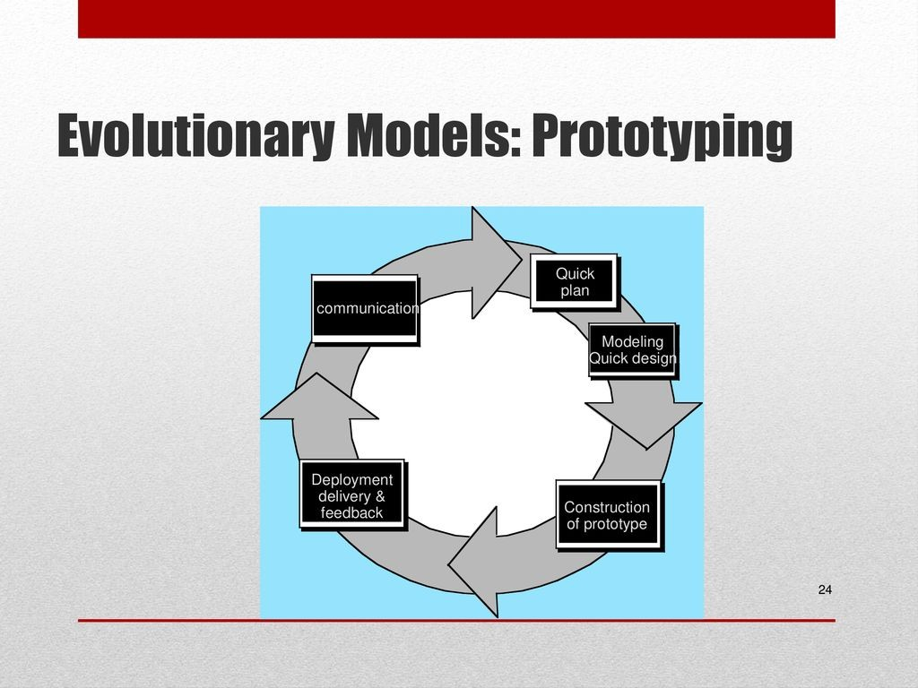

Slide 113
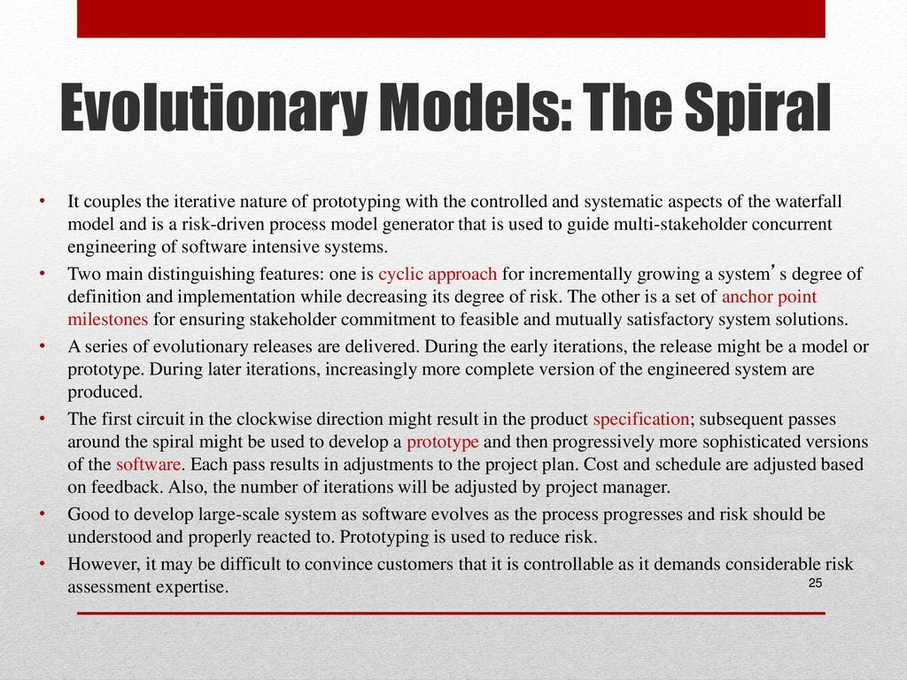

Slide 114
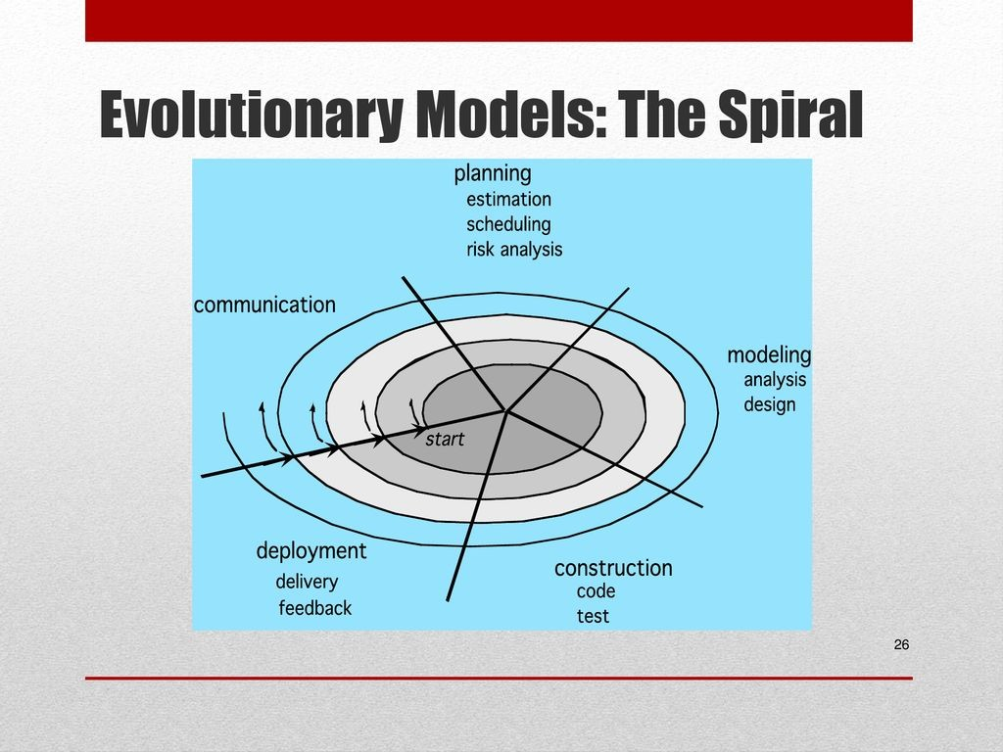

Slide 115
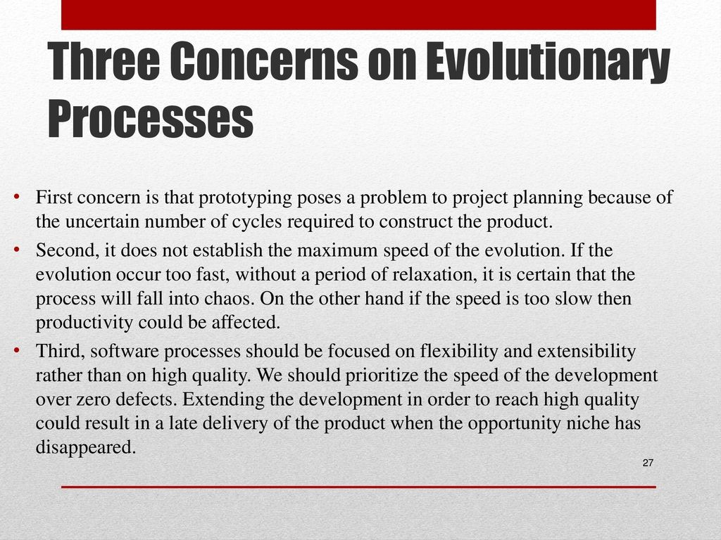

Slide 116
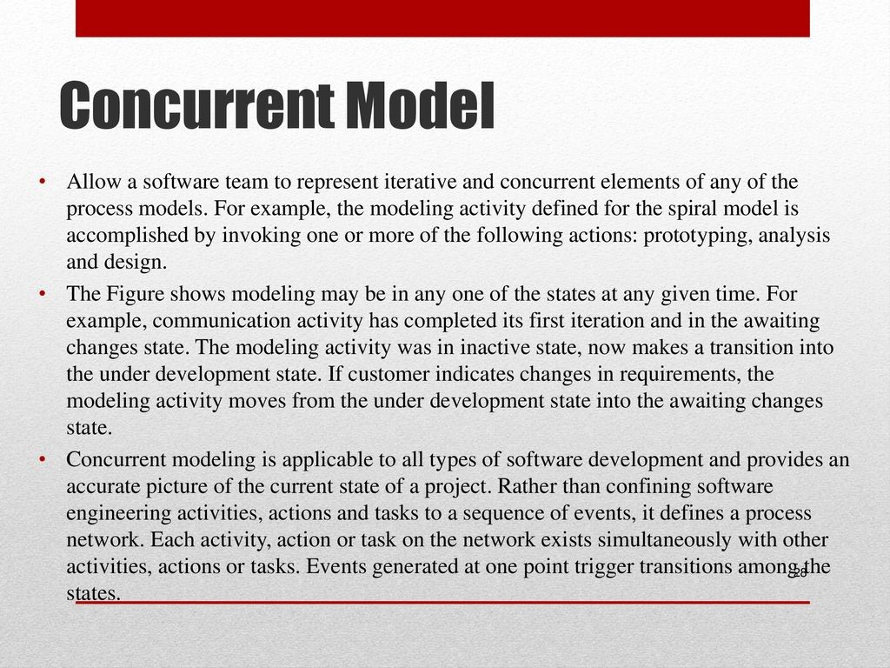

Slide 117
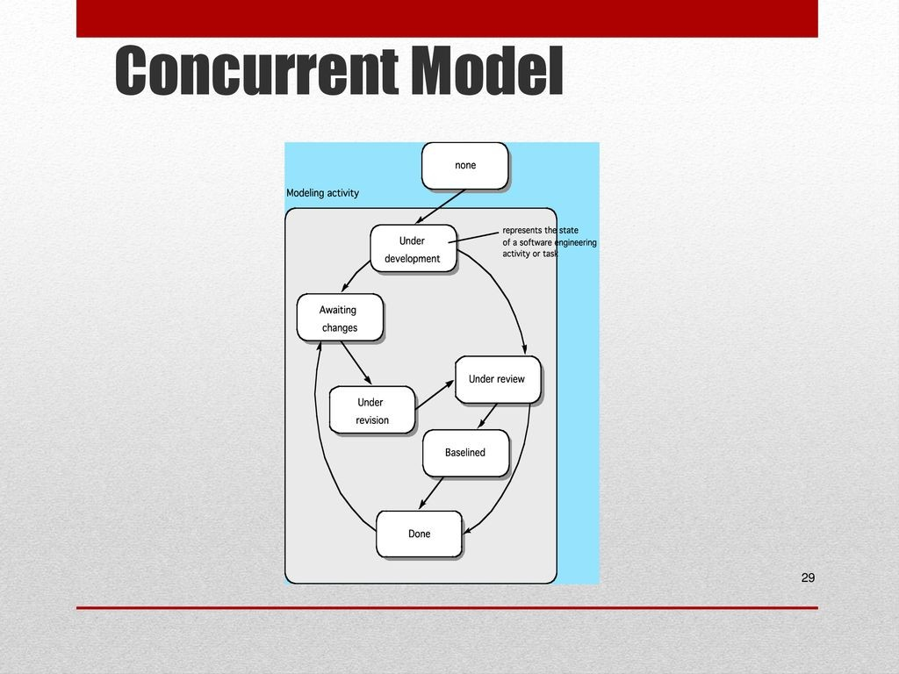

Slide 118
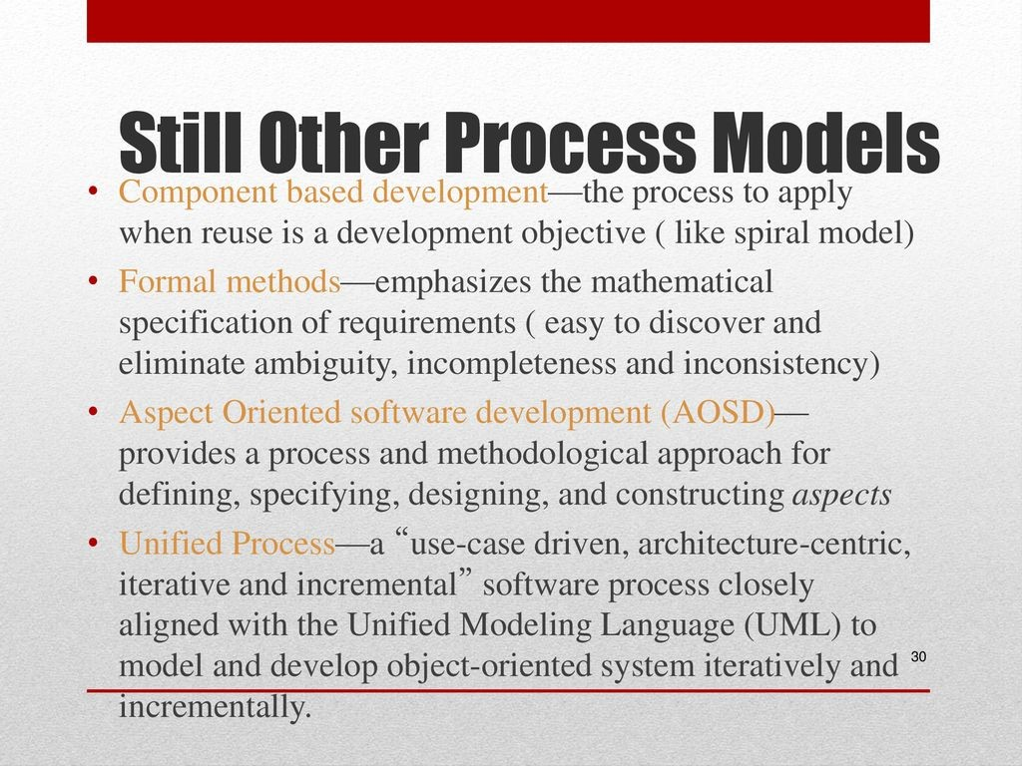

Slide 119
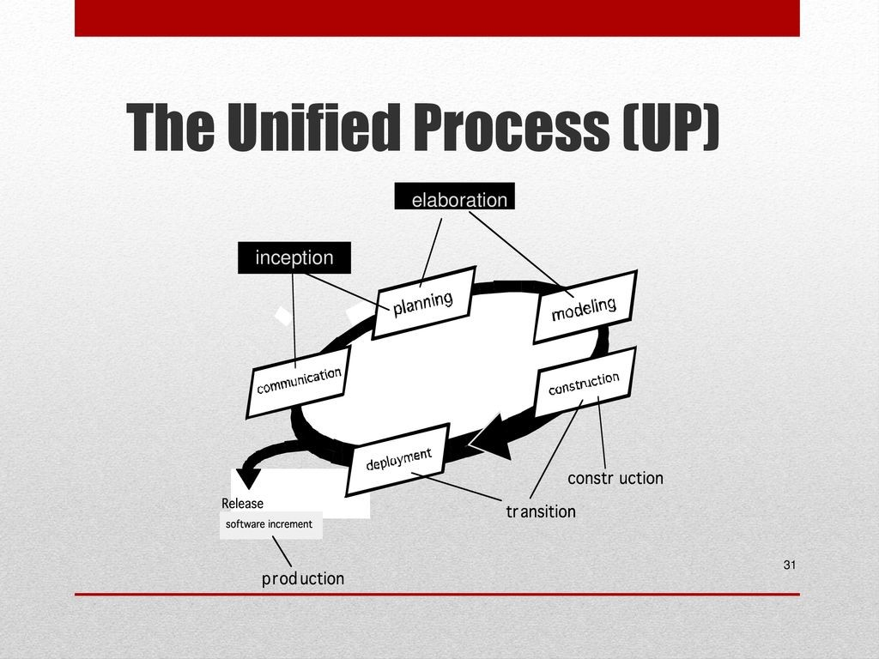

Slide 120
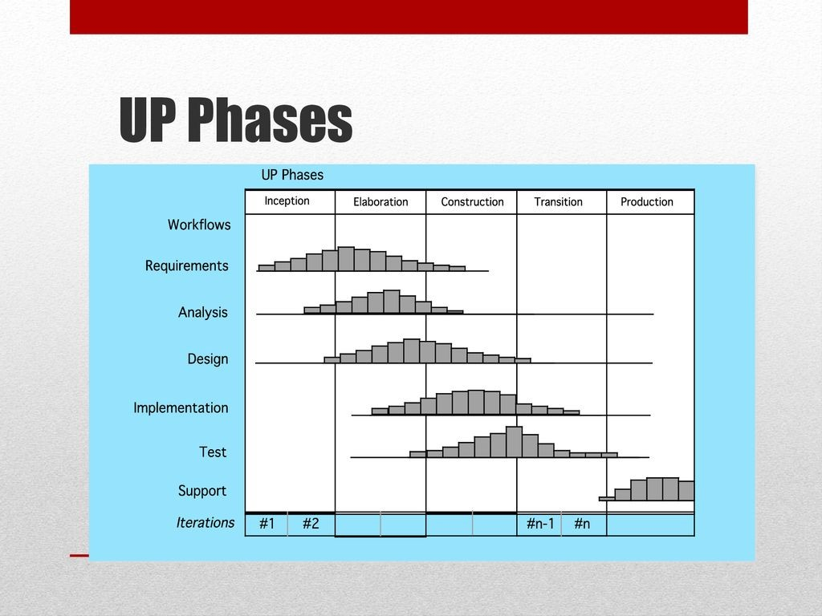

Slide 121
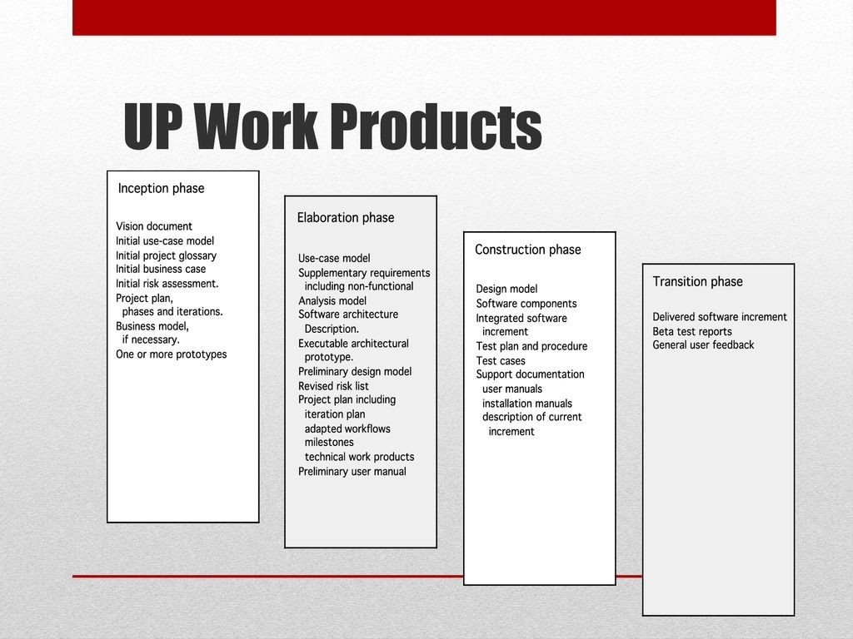

Slide 122
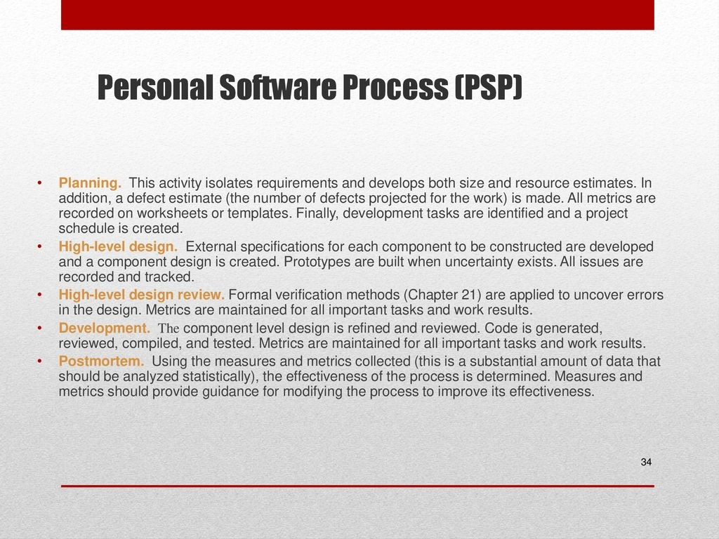

Slide 123
Personal Software Process (PSP)
Recommends five framework activities:
Planning
High-level design
High-level design review
Development
Postmortem
Stresses the need for each software engineer to identify errors early and as important, to understand the types of errors

Slide 124
Team Software Process (TSP)
Each project is “launched” using a “script” that defines the tasks to be accomplished
Teams (of 2 to 20 engineers) are self-directed
Plan and track work, set goals, own processes and plans
Measurement is encouraged.
Measures are analyzed with the intent of improving the team process (through coaching, motivation, …)

Slide 125
The Primary Goal of Any SW Process is
HIGH QUALITY
Remember:
High quality = project timeliness
Why?
Less rework!

Slide 126
Chapter 2: Summary
Software engineering encompasses process, methods, and tools that enable complex computer- based systems to be built in a timely manner with quality.
The software process incorporates five framework activities,communication, planning, modeling, construction, and deployment—that are applicable to all software projects.
Software engineering practice is a problem solving activity that follows a set of core principles.
A wide array of software myths continue to lead managers and practitioners astray, even as our collective knowledge of software and the technologies required to build it grows.

